Slide 1
Control of Robotic System – Final Project
Ankur Jain Chirag Majithia

Slide 2
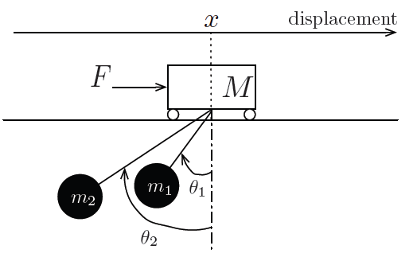
Mini Project System
Problem Overview
Given:
A cart of Mass M on which we can apply a controlled force F(t)
There are 2 masses, m1 and m2 suspended to the cart with mass-less string of length l1 and l2
X is the displacement of the cart from a reference. Similarly θ₁ and θ₂ are the angles formed by masses m1 and m2 with the reference axis attached to the cart.
Things to Do:
Check for observability of the system for given set of output vectors
Create a Luenberger Observer for the system with the output vectors for which it was observable
Design Output Feedback for the System

Slide 3
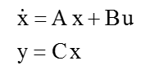
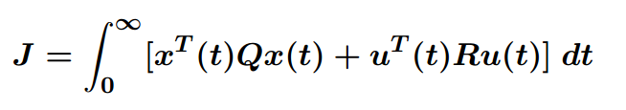
LQR design
For a given system we want to design a
control such that U(t) = K x(t)
The design of K is a trade-off between the desired response and the control effort.
The cost function for the system is given by

Slide 4


LQR design
Q and R are weighting matrices that are positive semi-definite and positive definite respectively. The weighting matrices allow to put individual emphasis on the different components of the state- and controllable input.
$$\begin{matrix}\begin{matrix}Q11 & \\ & Q22\end{matrix} & \begin{matrix} & \\ & \end{matrix} & \begin{matrix} & \\ & \end{matrix} \\ \begin{matrix} & \\ & \end{matrix} & \begin{matrix}Q33 & \\ & Q44\end{matrix} & \begin{matrix} & \\ & \end{matrix} \\ \begin{matrix} & \\ & \end{matrix} & \begin{matrix} & \\ & \end{matrix} & \begin{matrix}Q55 & \\ & Q66\end{matrix}\end{matrix}$$
$$\begin{matrix}x1 \\ \begin{matrix}x2 \\ \begin{matrix}x3 \\ x4 \\ \begin{matrix}x5 \\ x6\end{matrix}\end{matrix}\end{matrix}\end{matrix}$$
Q =
corresponding to states
R = R₁₁ corresponding to control input U(t)

Slide 5

LQR DESGIN
Selection of Q and R
If a reference is given to the system, the Q will effectively weight the error i.e. difference between the current state and the desired value.
For our system, the stable equilibrium points of θ$1$ and θ₂ are found to be at 2*K*pi radians where K $ε \{0,1,2,..\}$
Where as it was found that the system can be stable at any given X
Thus, we weight Q₃₃ ~ Q₆₆ more to maintain the system within linearizable range.
And we weight Q₂₂ little more than Q₁₁ since we need the system to smoothly come to 0 at the equilibrium point {(Q₂₂) weights velocity of the cart}

Slide 6
LQR Design
In Matlab:
[K, S, e] = lqr(A,B, Q, R) solves the Riccati equation
A’ P + P A − P BR⁻¹B’ P = -Q
K = R⁻¹B’ P
The return values: −K is the state feedback gain matrix.
S is the solution of the algebraic Riccati equation.
e are the resulting closed loop eigenvalues (i.e. the eigenvalues of A − BK).
Using : R = 0.00001 ; and Q = [ 10 0 0 0 0 0;
0 100 0 0 0 0;
0 0 1000*l1 0 0 0;
0 0 0 100*l1^2 0 0;
0 0 0 0 1000*l2 0;
0 0 0 0 0 100*l2^2];
[K,S,e] = lqr(A,B,Q,R)
We get following K matrix and eigen values :
K = 1.0e+04 * [ 0.1000 0.5535 4.8697 5.5201 4.0664 -1.5867 ]
e = -5.3080 + 0.0000i -0.3616 + 0.0000i -0.3619 + 0.4519i -0.3619 - 0.4519i
-0.1575 + 0.8494i -0.1575 - 0.8494i

Slide 7
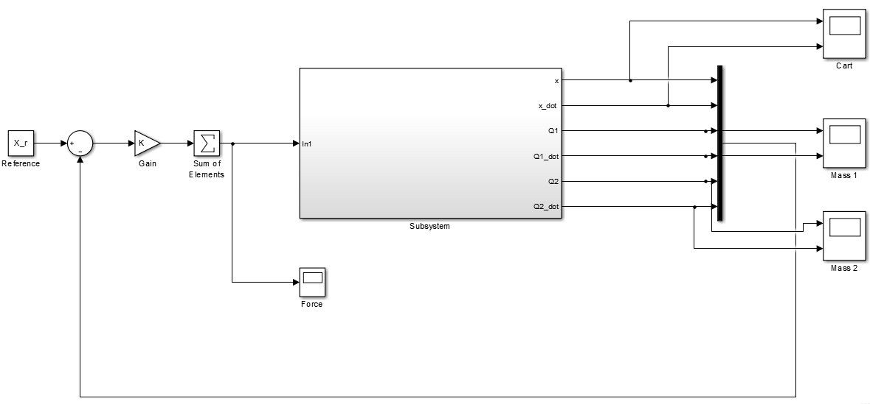
LQR design
Let’s test our Q and R! Applying K to the non linear system X(0) = [10 0 90 0 -90 0]

Slide 8
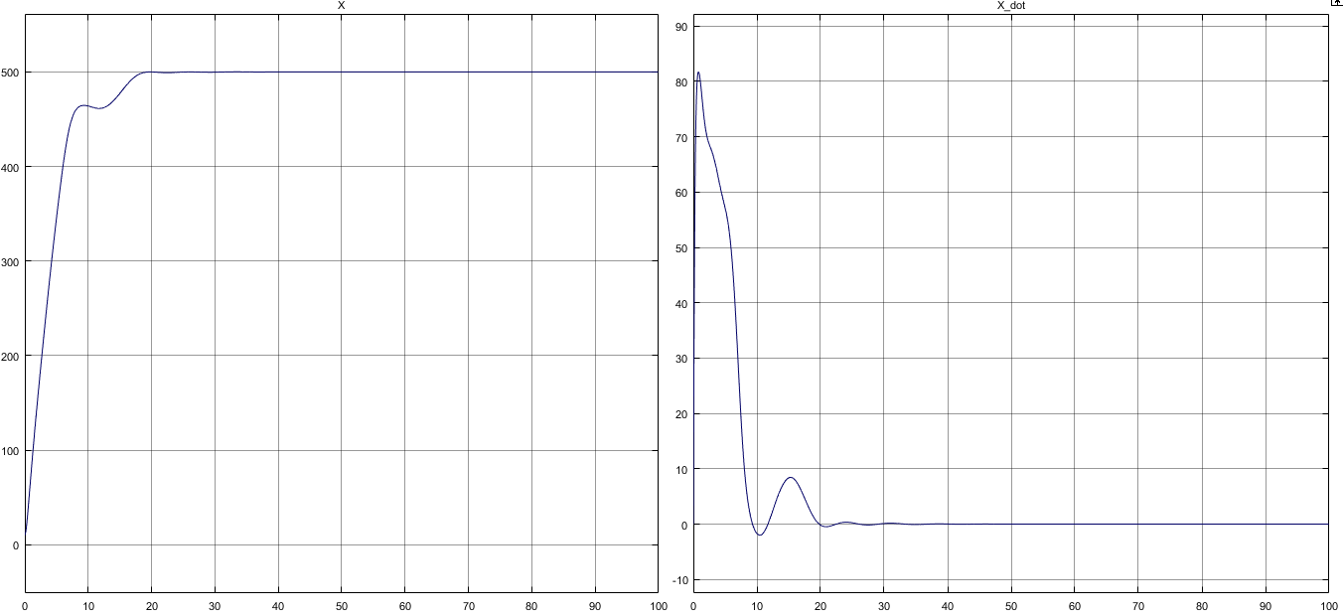
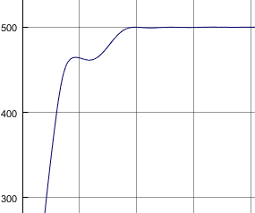
LQR Design
Let’s test our Q and R! Applying K to the non linear system X(0) = [10 0 90 0 -90 0]

Slide 9
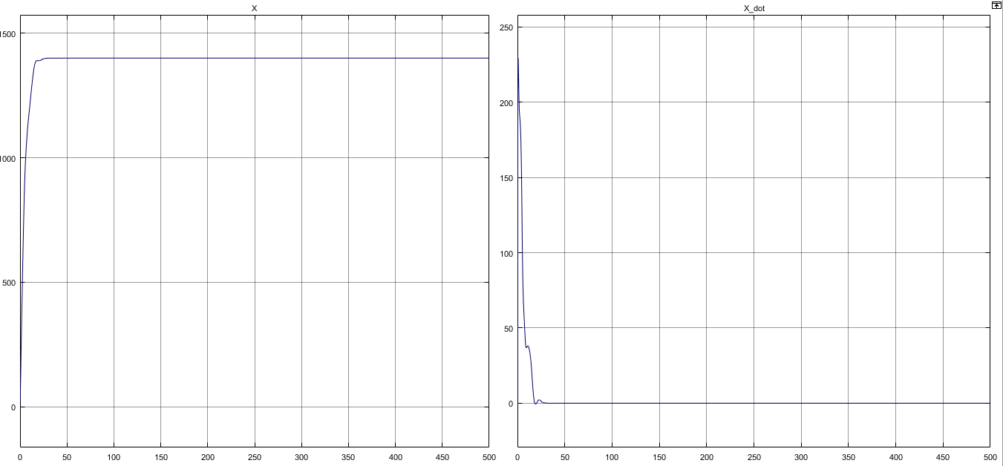
LQR Design
Cool! It works! Lets push the limits of the cart -- I mean the controller!
X_ref = 1400

Slide 10
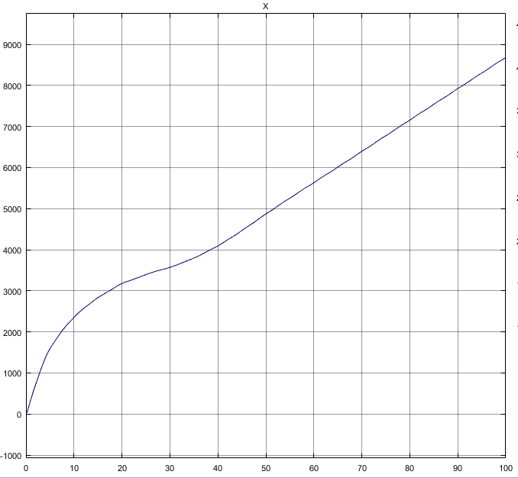
LQR design
Cool! It works! Lets push the limits of the cart -- I mean the controller!
X_ref = 2500
Why did it fail!?

Slide 11
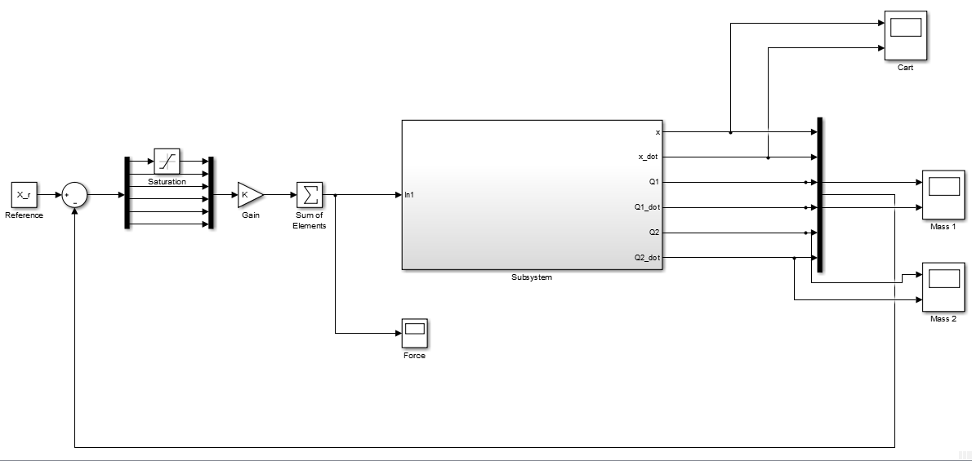
LQR Design
Can this be Generalized?
Yes! Saturate the error that is making the system lose linearity!

Slide 12
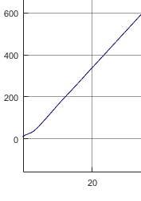
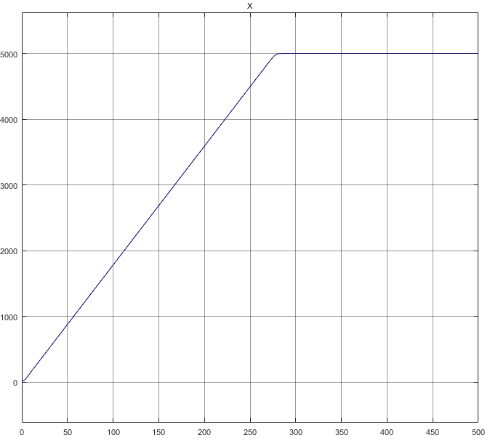
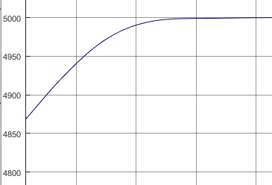
LQR Design
Output After saturating error in X : Graph of X vs Time
Starts at X(0) = 10
Converges at X(t) = 5000

Slide 13
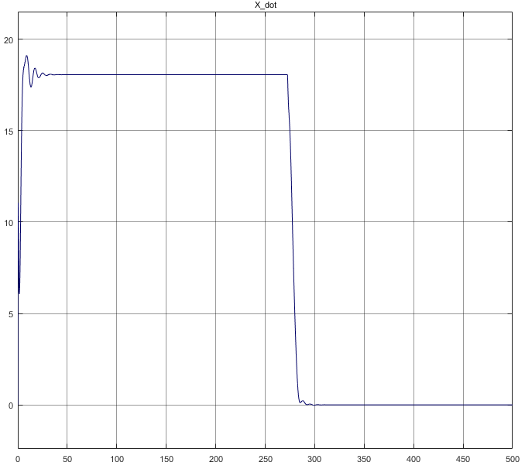
LQR Design
Output After saturating error in X :: Graph X_dot vs Time
Notice the cart goes with constant Velocity!

Slide 14

LQR Design
Why does x_dot become constant?
Fnet = m$\frac{d2x}{dt}$ = k₁ * (X(t)-X_{ref}) + k₂ *( $\frac{dx(t)}{dt}$ - $vref)$
When (X(t)-X_{ref}) saturates : k₁ * (X(t)-X_{ref}) is constant
Hence,
At equilibrium of this 2 opposing forces – the acceleration of the Cart is 0
$\frac{dx(t)}{dt}$ = k1*X_{sat}/k2

Slide 15
LQR Design
Since, the value of K is stable for almost Xref = 1500, we use it with our Observer for Output Feedback Controller with estimated states

Slide 16
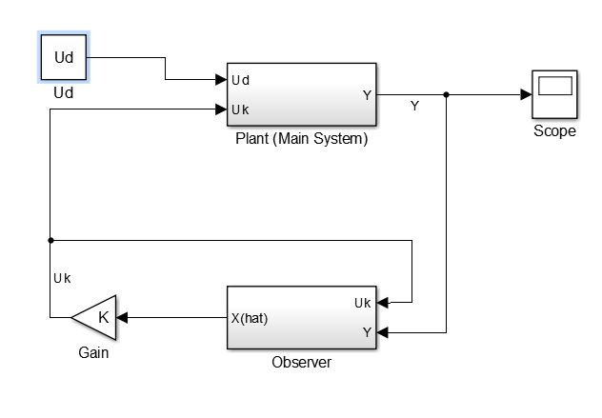
Luenberger Observer for a system

Slide 17
Luenberger Observer for a system
A system’s observer can also be called its estimator as it tries to mimic the system and gives an output that it believes will be the output for the system for the given control input.
The observer is generally used when not all the states of the system can be known because of a restriction on the number or type of sensors available.
The observer takes advantage of the dynamics of the system rather than using derivatives to get estimates of the unknown states.

Slide 18
Overall Design Process
The principle of separation of estimation and control:
The problem of designing an optimal feedback controller can be solved by designing an optimal observer for the state of the system, which feeds into an optimal controller for the system
Hence we use LQR to design optimal controller gains,
and use pole placement method to determine L

Slide 19
Design of Luenberger Observer
Let the system be given by following State Space
u
y
Observer
+
-
C
The Luenberger Observer is thus given by:
where denotes the estimate of all the states. The matrix L is the observer gain matrix for the error correction variable, as it takes into account, the difference between the exact output from real system and the estimated state

Slide 20
The Pole Placement Method
The aim behind Pole placement is that we pick the control gains such that the actual Eigen values of the closed loop system match the desired Eigen values.
It isn’t always possible
The Eigen Values chosen can’t be random.
K = place(A, B, EigenValues);

Slide 21
Observer + Controller
System model
u
x
C
y
Observer
Control
+
-K
-
C
Observer + Controller
Here, we use estimated states to generate the controlled input.

Slide 22
Observable Linearized Systems
Our linearized system is observable if the rank of [C CA …. CA⁵]’ = 6
We have A for linearized system as :=
The various output vectors provided to us along with the rank from above formula are:
0 1 0 0 0 0
0 0 -(m1*g)/M 0 -(m2*g)/M, 0
0 0 0 1 0 0
0 0 -(M+m1)*g/M/l1 0 -(m2*g)/M/l1 0
0 0 0 0 0 1
0 0 -(m1*g)/M/l2 0 -(M+m2)*g/M/l2 0]
0 1.0000 0 0 0 0
0 0 -0.9800 0 -0.9800 0
0 0 0 1.0000 0 0
0 0 -0.5390 0 -0.0490 0
0 0 0 0 0 1.0000
0 0 -0.0980 0 -1.0780 0
⁼
x(t) | C = [1 0 0 0 0 0] | 6 | Observable
(θ1(t), θ2(t)) | C = [0 0 1 0 0 0; 0 0 0 0 1 0]; | 4 | Not-observable
(x(t), θ2(t)) | C = [1 0 0 0 0 0 0 0 0 0 1 0]; | 6 | Observable
(x(t), θ1(t), θ2(t)) | C = [1 0 0 0 0 0; 0 0 1 0 0 0; 0 0 0 0 1 0] | 6 | Observable

Slide 23
Actual Design
Using : R = 0.0005 ; and
Q=[ 1 0 0 0 0 0;
0 500 0 0 0 0;
0 0 700 0 0 0;
0 0 0 700 0 0;
0 0 0 0 500 0;
0 0 0 0 0 500];
[K,S,e] = lqr(A,B,Q,R) We get following K matrix and Eigen values :
K = 1.0e+03 * [0.0447 1.0581 0.6561 0.8684 0.6857 0.4115]
e = -0.9153 + 0.0000i -0.0448 + 0.0000i
-0.0600 + 1.0138i -0.0600 - 1.0138i
-0.0313 + 0.7120i -0.0313 - 0.7120i
EigenL= 3*e;
Lx_t = place(A',Cx',EigenL);
Lx=Lx_t'; Ax_obs = [A-Lx*Cx];
Bx_obs = [B Lx];
Cx_obs = Cx;
Dx_obs = <Zeroes matrix> ;
X_0_x_obs = [0 0 0 0 0 0];

Slide 24
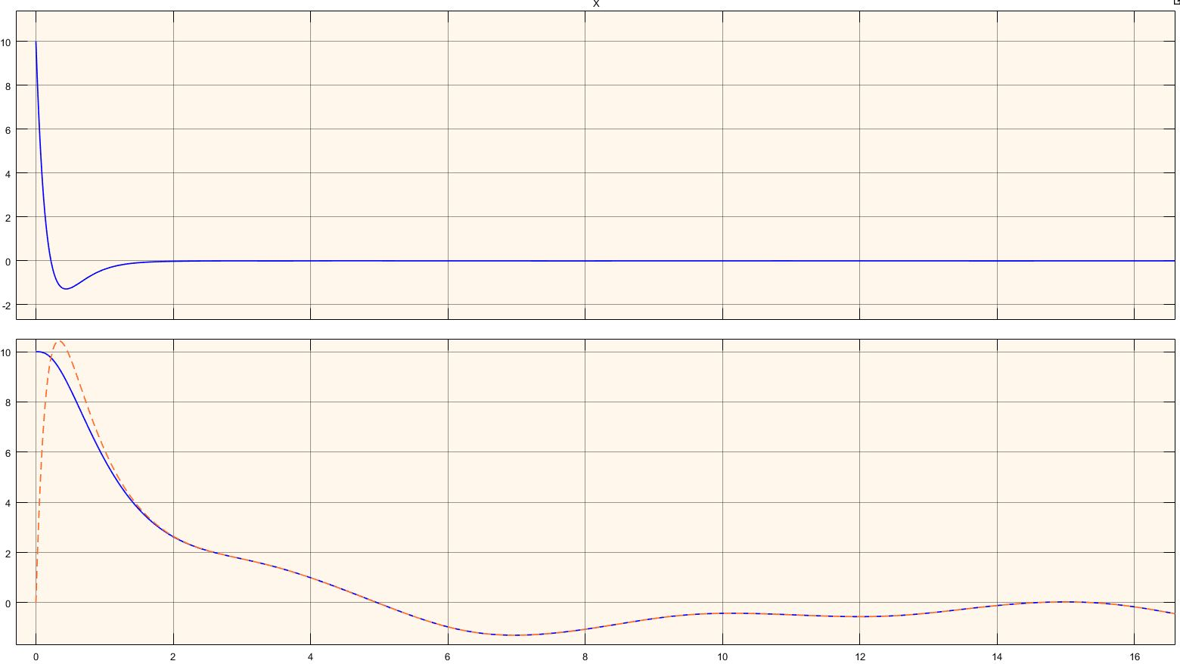
Zero Reference and all negative poles: Observer tracing the Output Vector x(t)

Slide 25
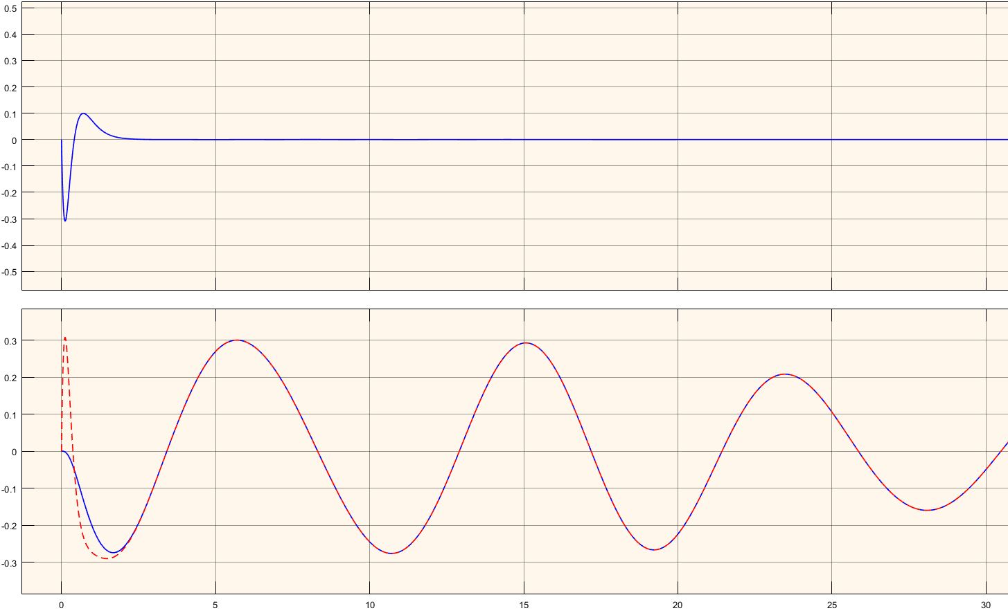
Zero Reference and all negative poles : Observer tracing the Output Vector θ1(t)

Slide 26
Zero Reference and all negative poles : Observer tracing the Output Vector θ2(t)

Slide 27
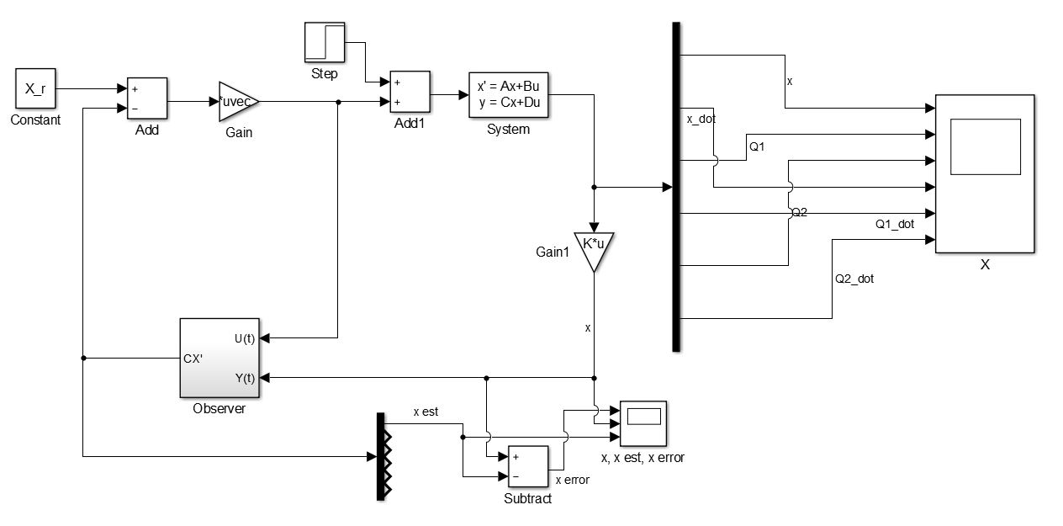
Linearized System for Output Vector x(t)

Slide 28
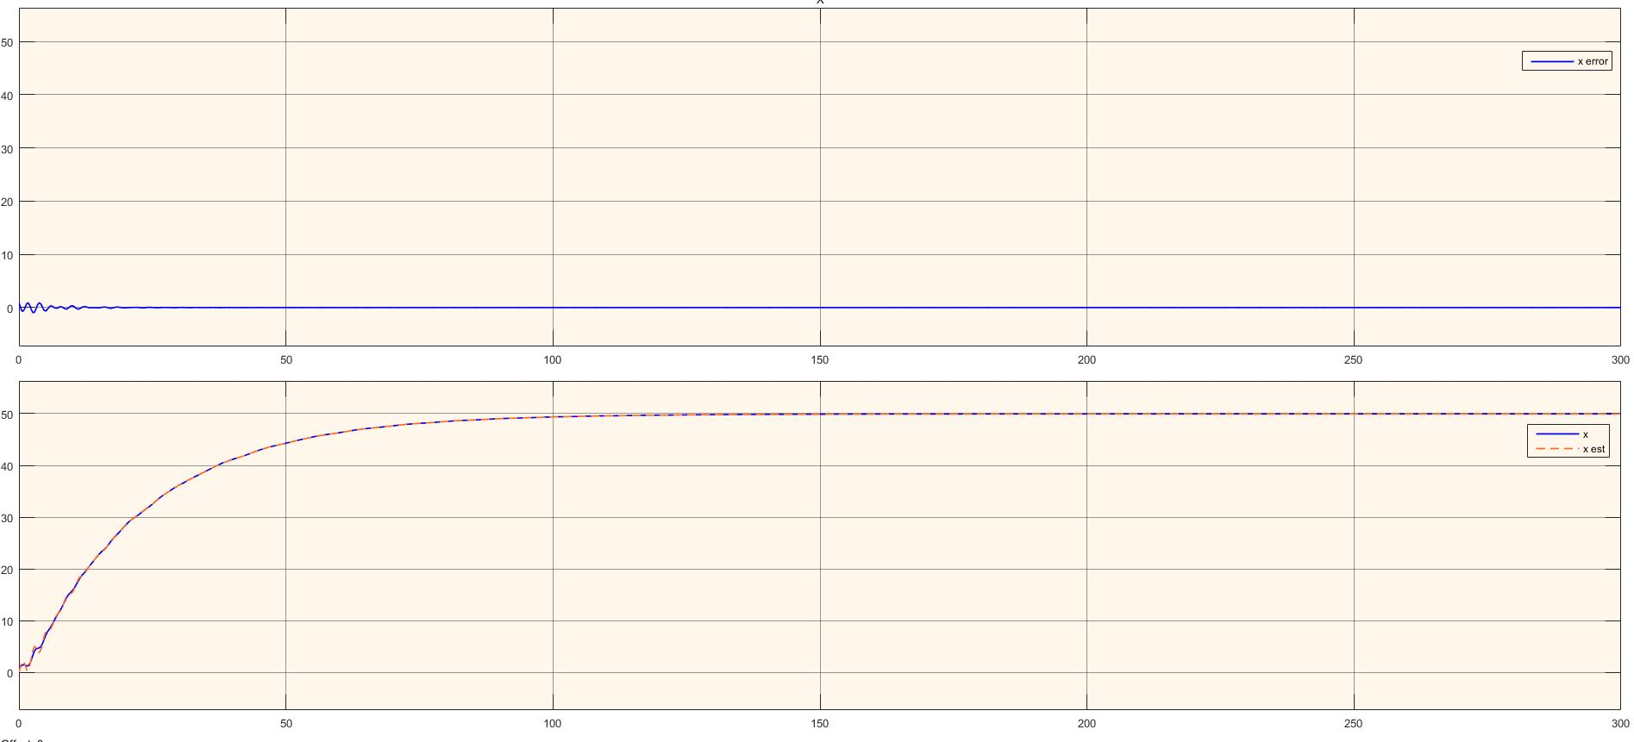
Observer tracing the Output Vector x(t)

Slide 29
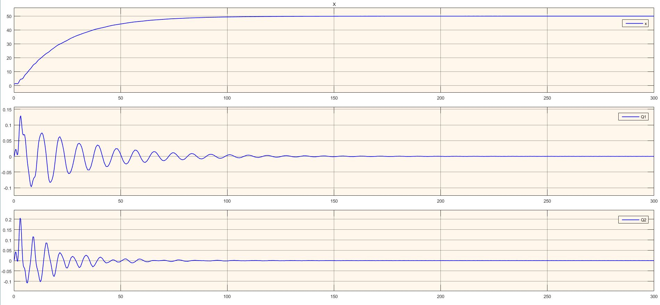
The (x, θ1(t), θ2(t)) States of the System

Slide 30
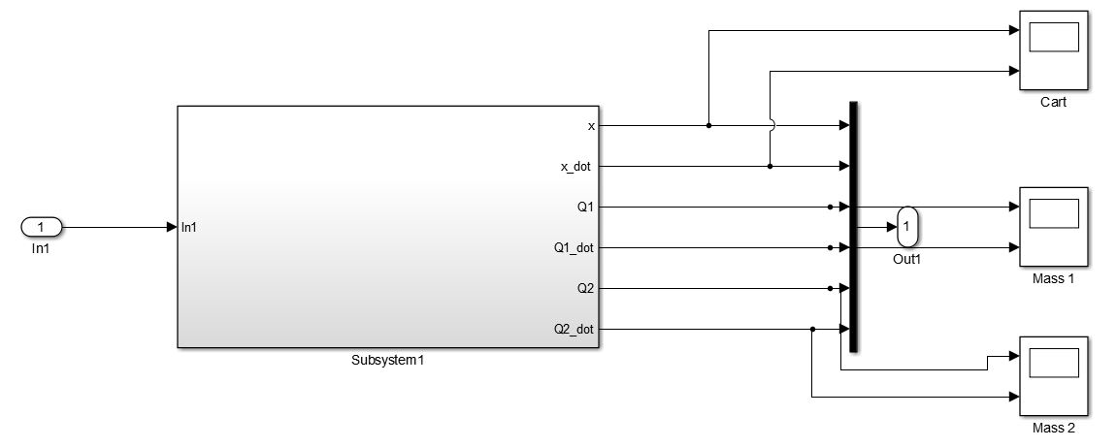
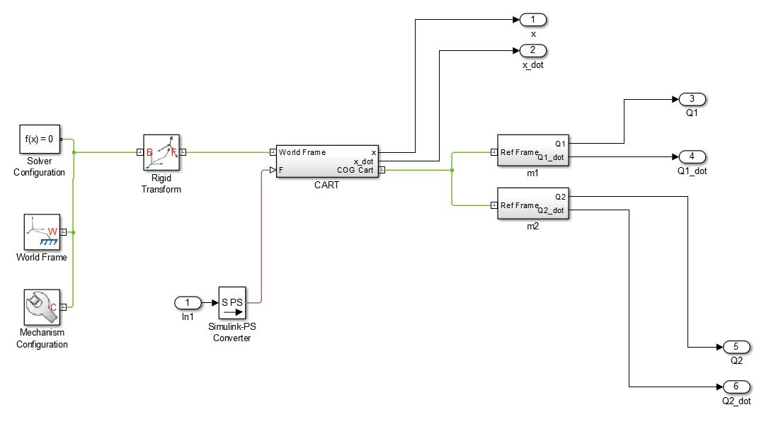
Non-Linearized System

Slide 31
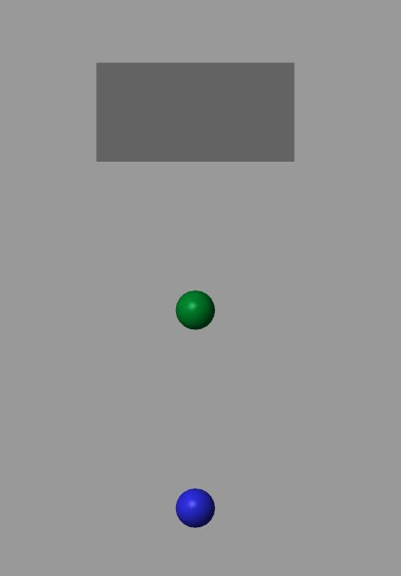
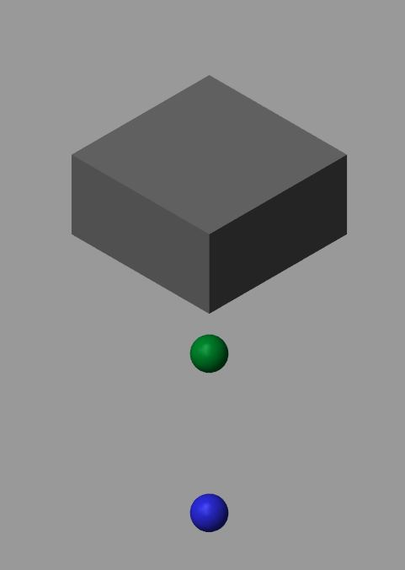
Non-Linearized System

Slide 32
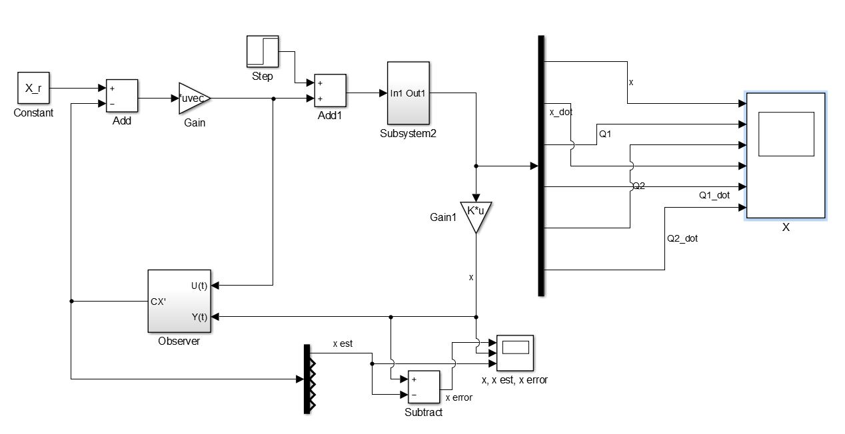
Non-Linearized System for Output Vector x(t)

Slide 33
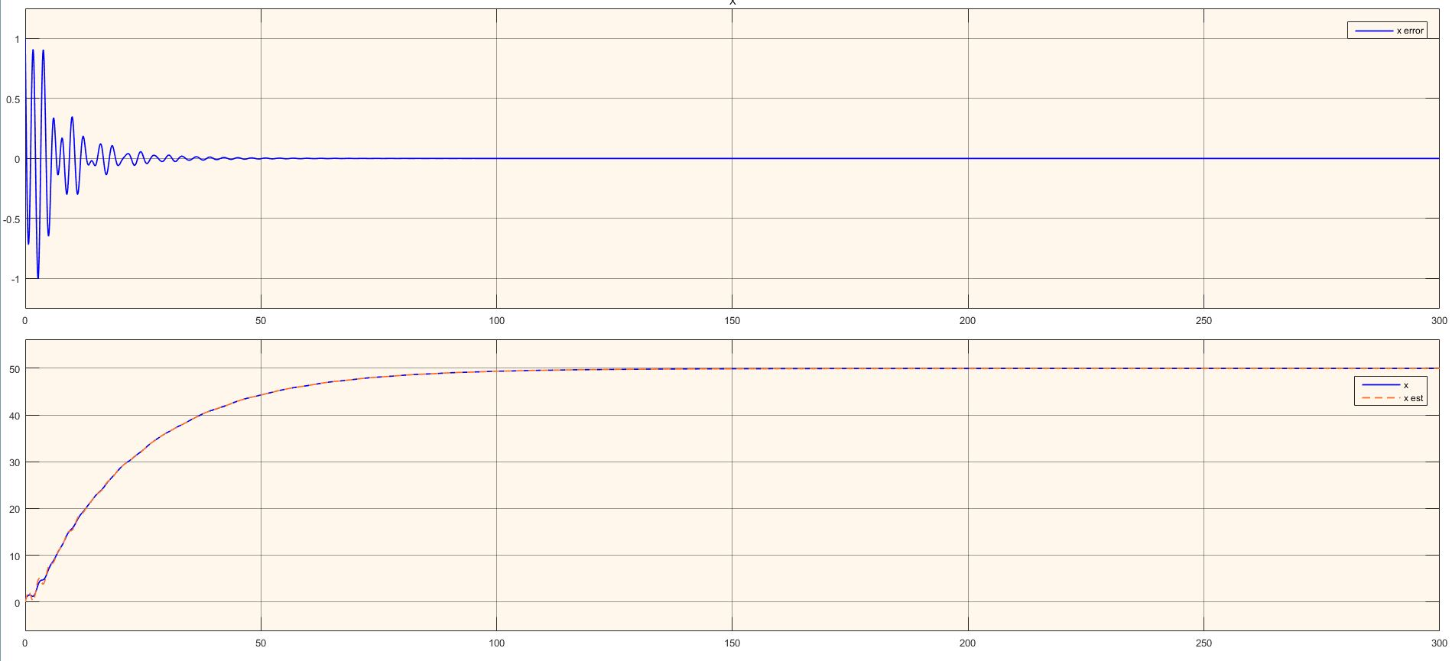
Observer tracing the Output Vector x(t)

Slide 34
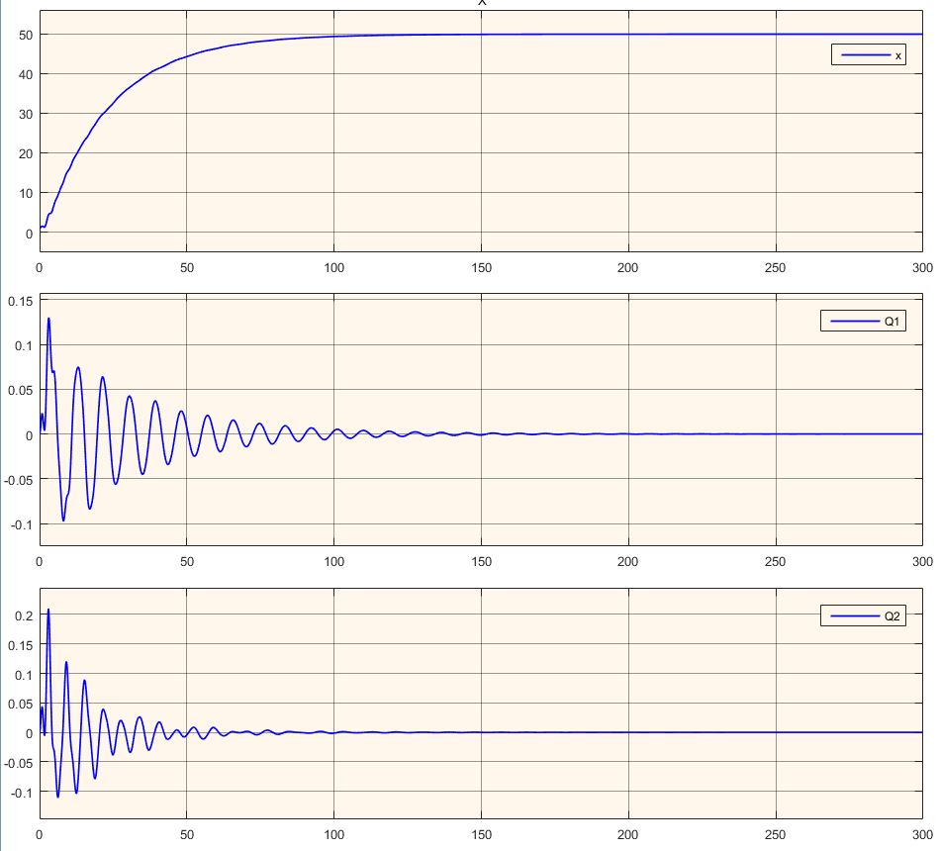
The (x, θ1(t), θ2(t)) States of the System

Slide 35
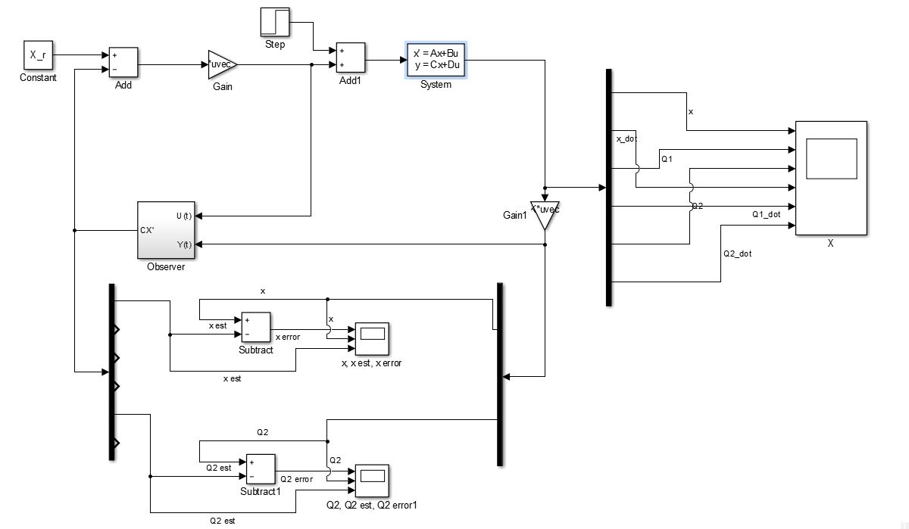
Linearized System for Output Vector (x(t), θ2(t))

Slide 36
Observer tracing the Output Vector x(t)

Slide 37
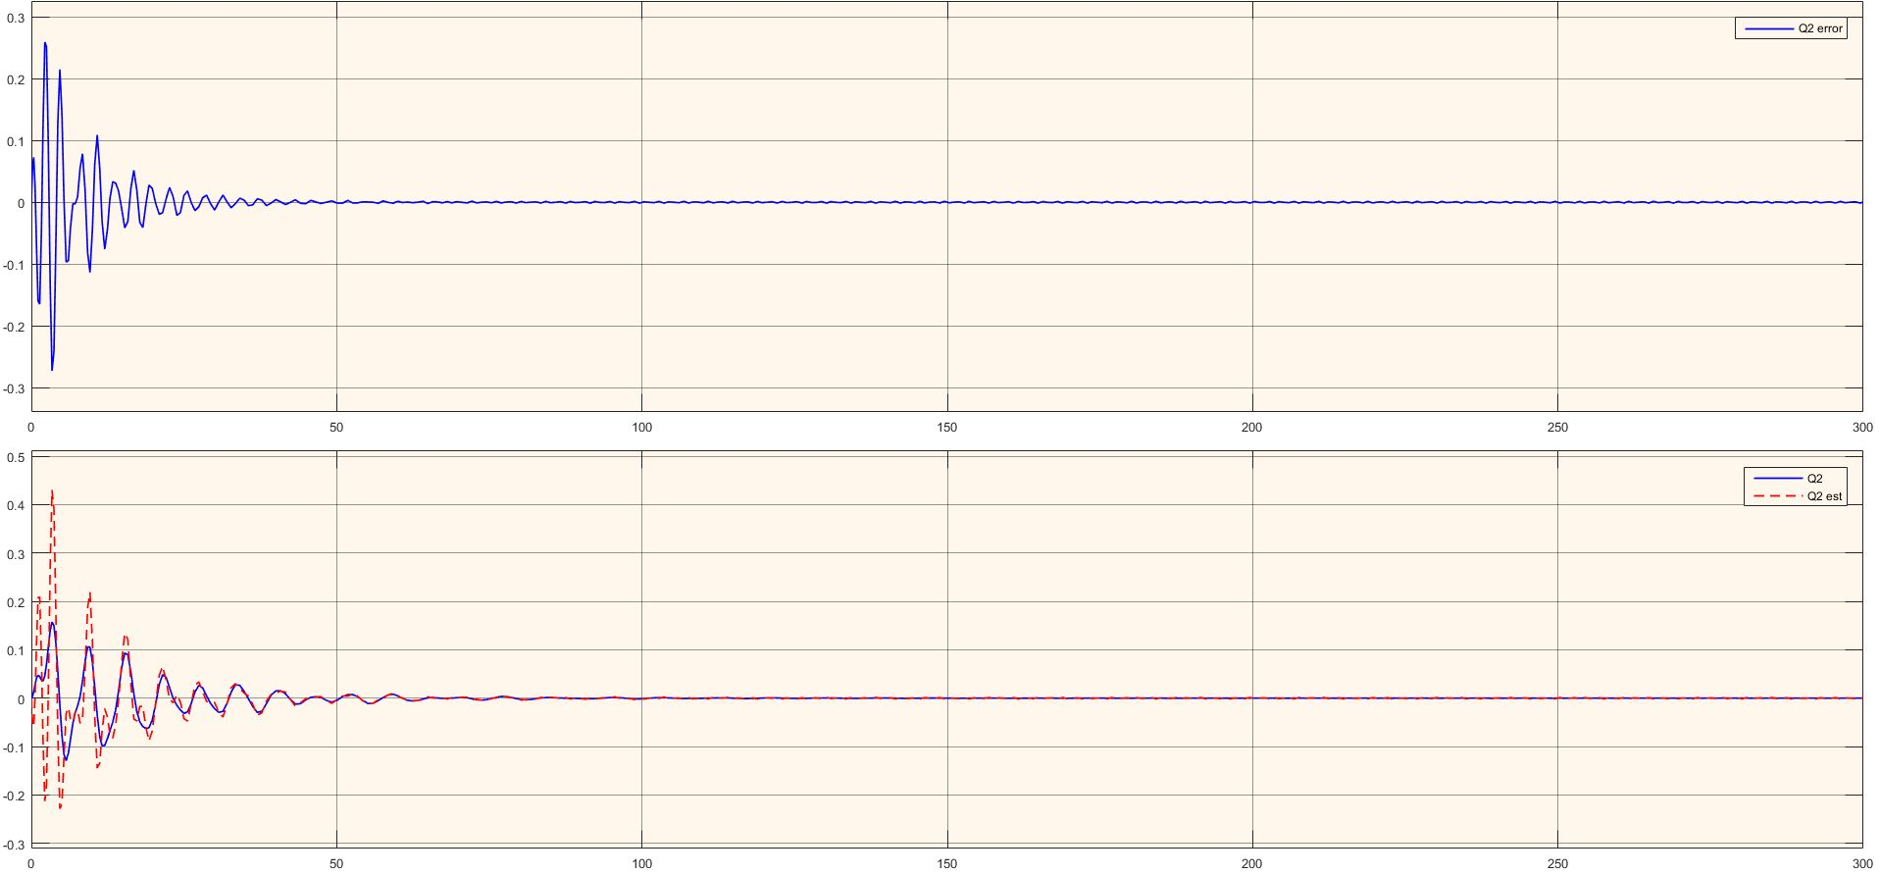
Observer tracing the Output Vector θ2(t)

Slide 38
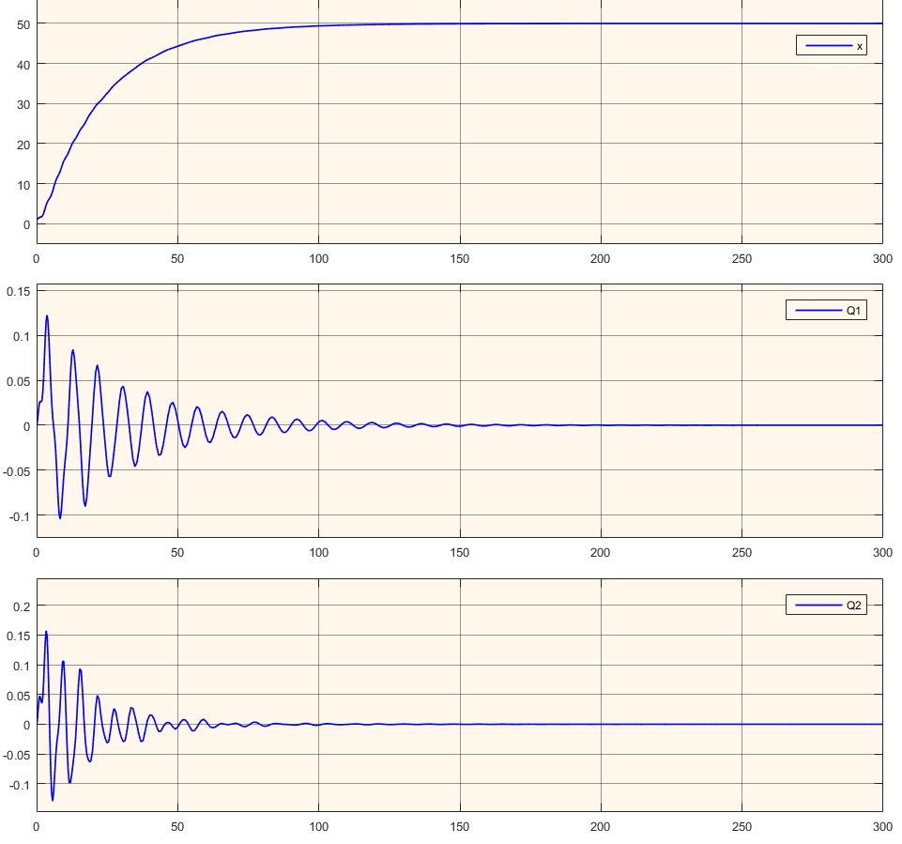
The (x, θ1(t), θ2(t)) States of the System

Slide 39
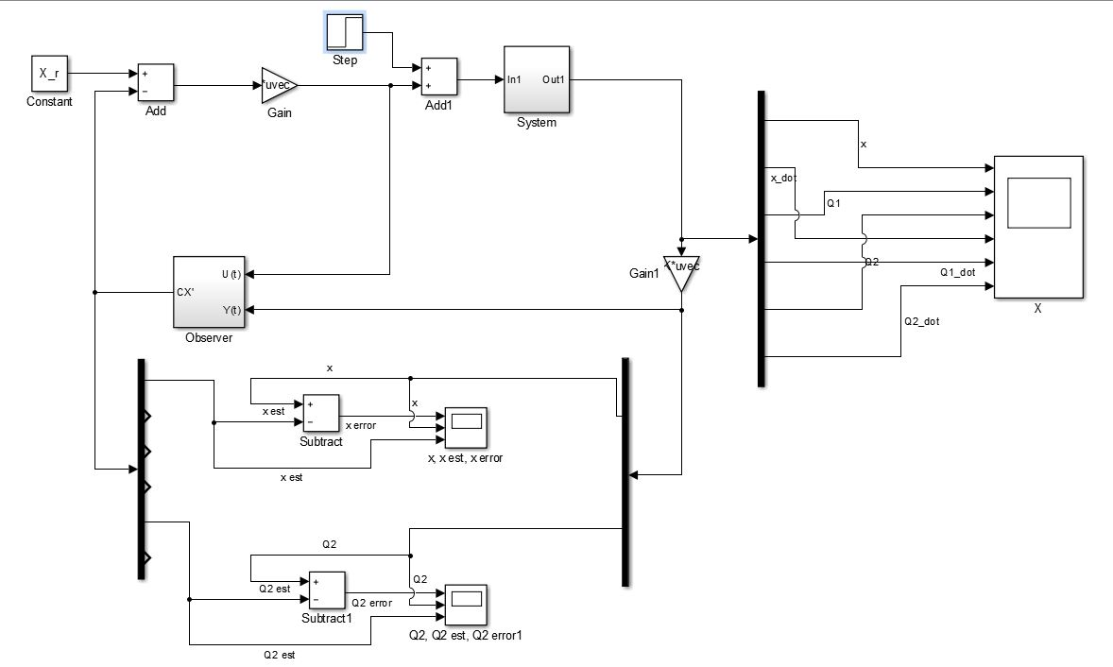
Non-Linearized System for Output Vector (x(t), θ2(t))

Slide 40
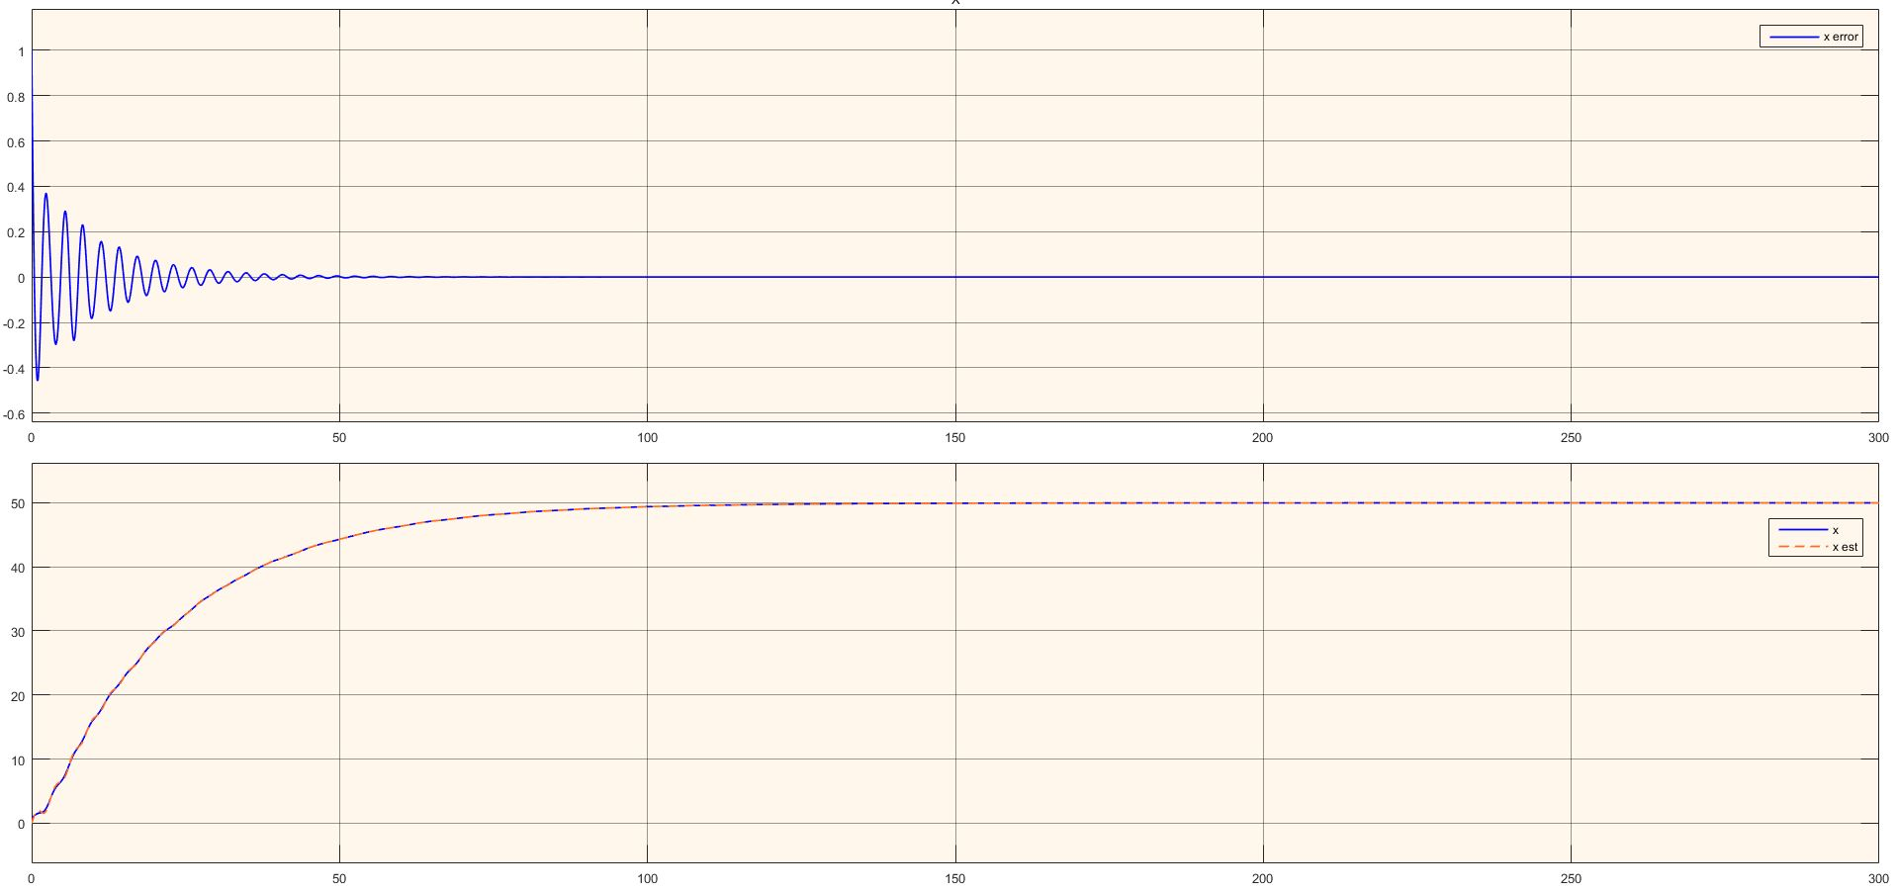
Observer tracing the Output Vector x(t)

Slide 41
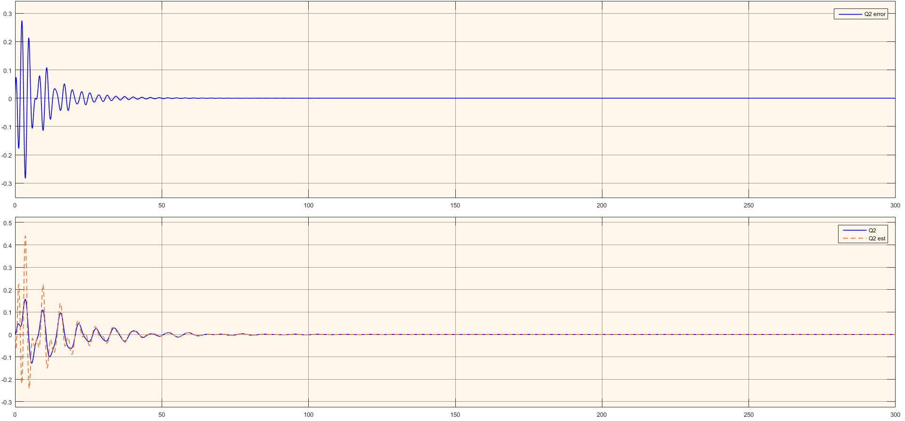
Observer tracing the Output Vector θ2(t)

Slide 42
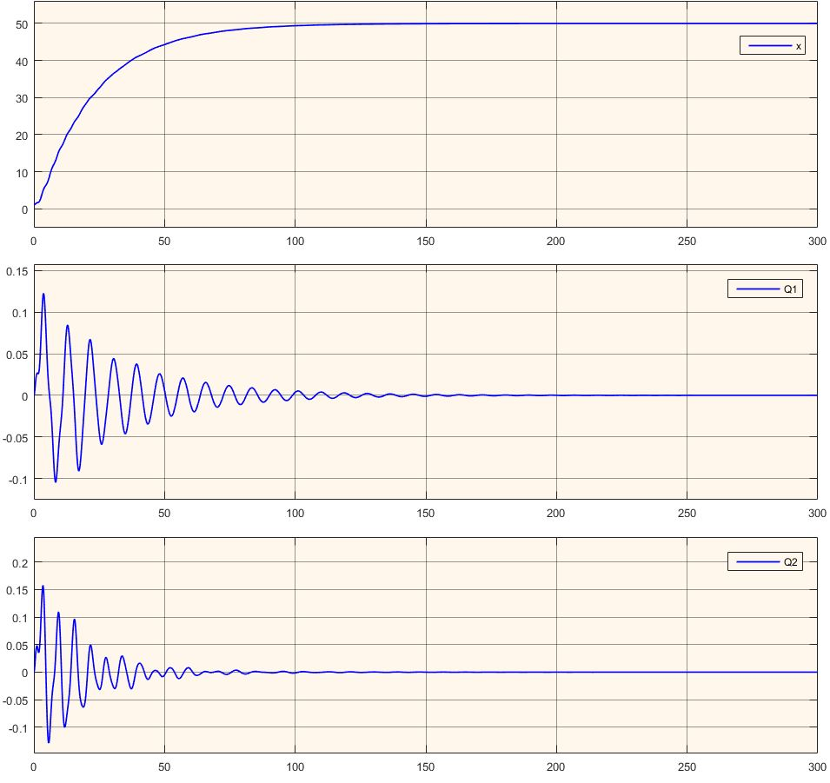
The (x, θ1(t), θ2(t)) States of the System

Slide 43
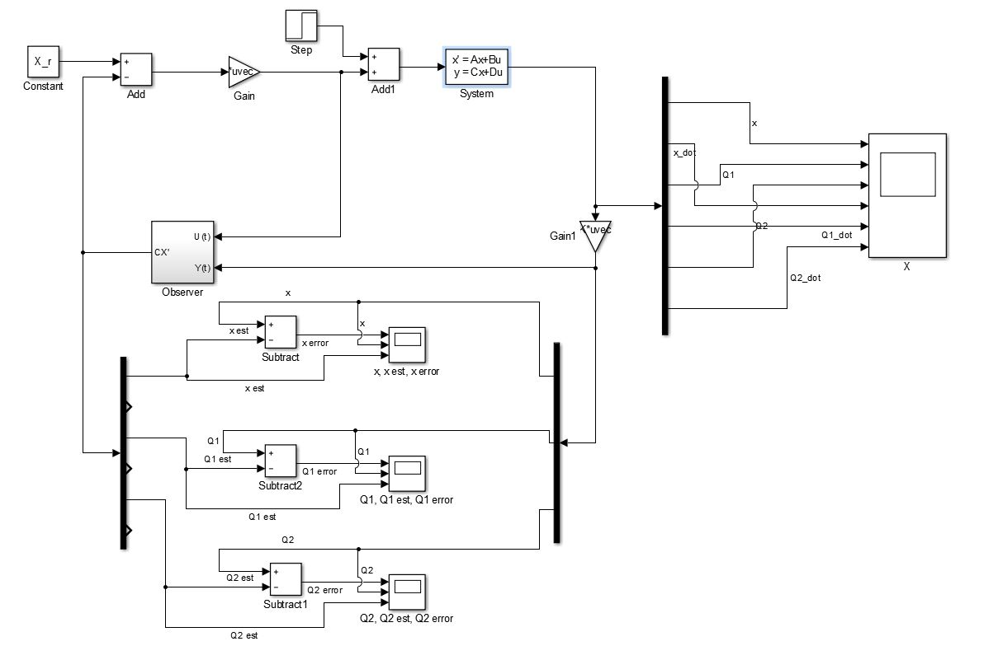
Linearized System for Output Vector (x(t), θ1(t), θ2(t))

Slide 44
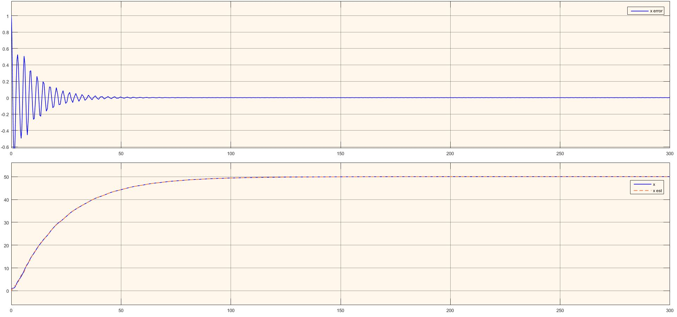
Observer tracing the Output Vector x(t)

Slide 45
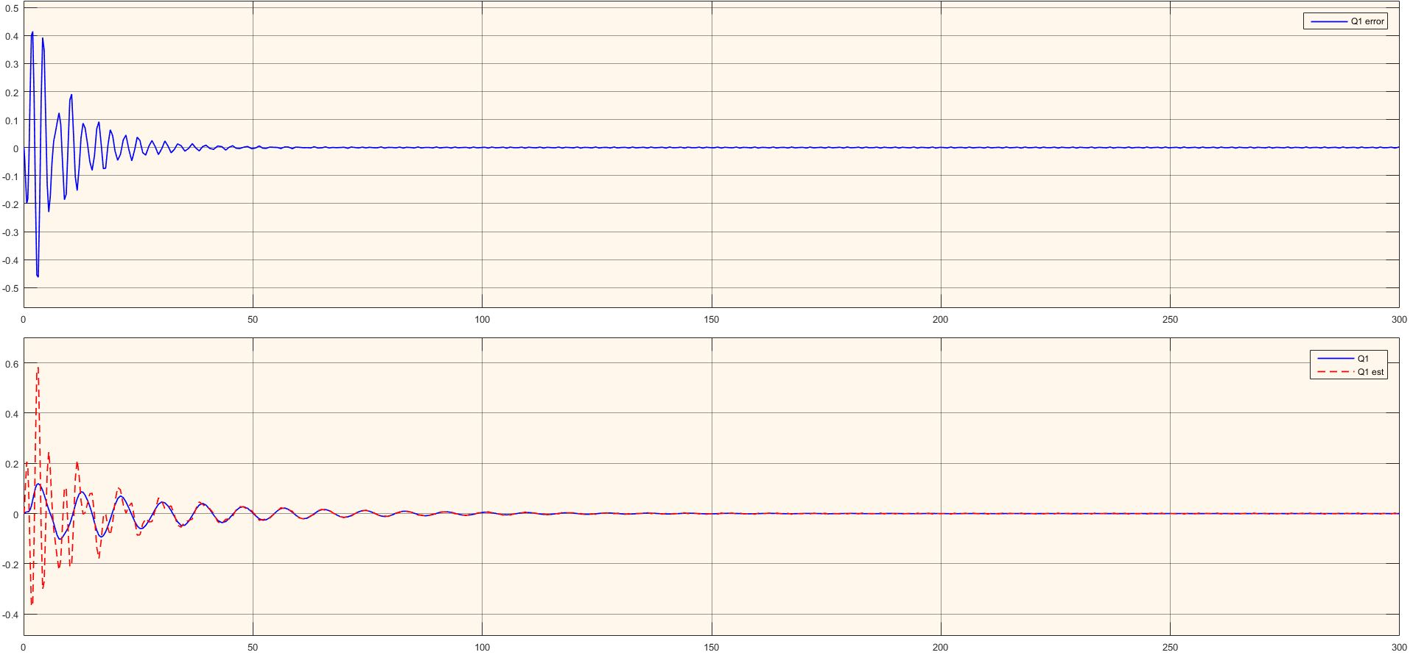
Observer tracing the Output Vector θ1(t)

Slide 46
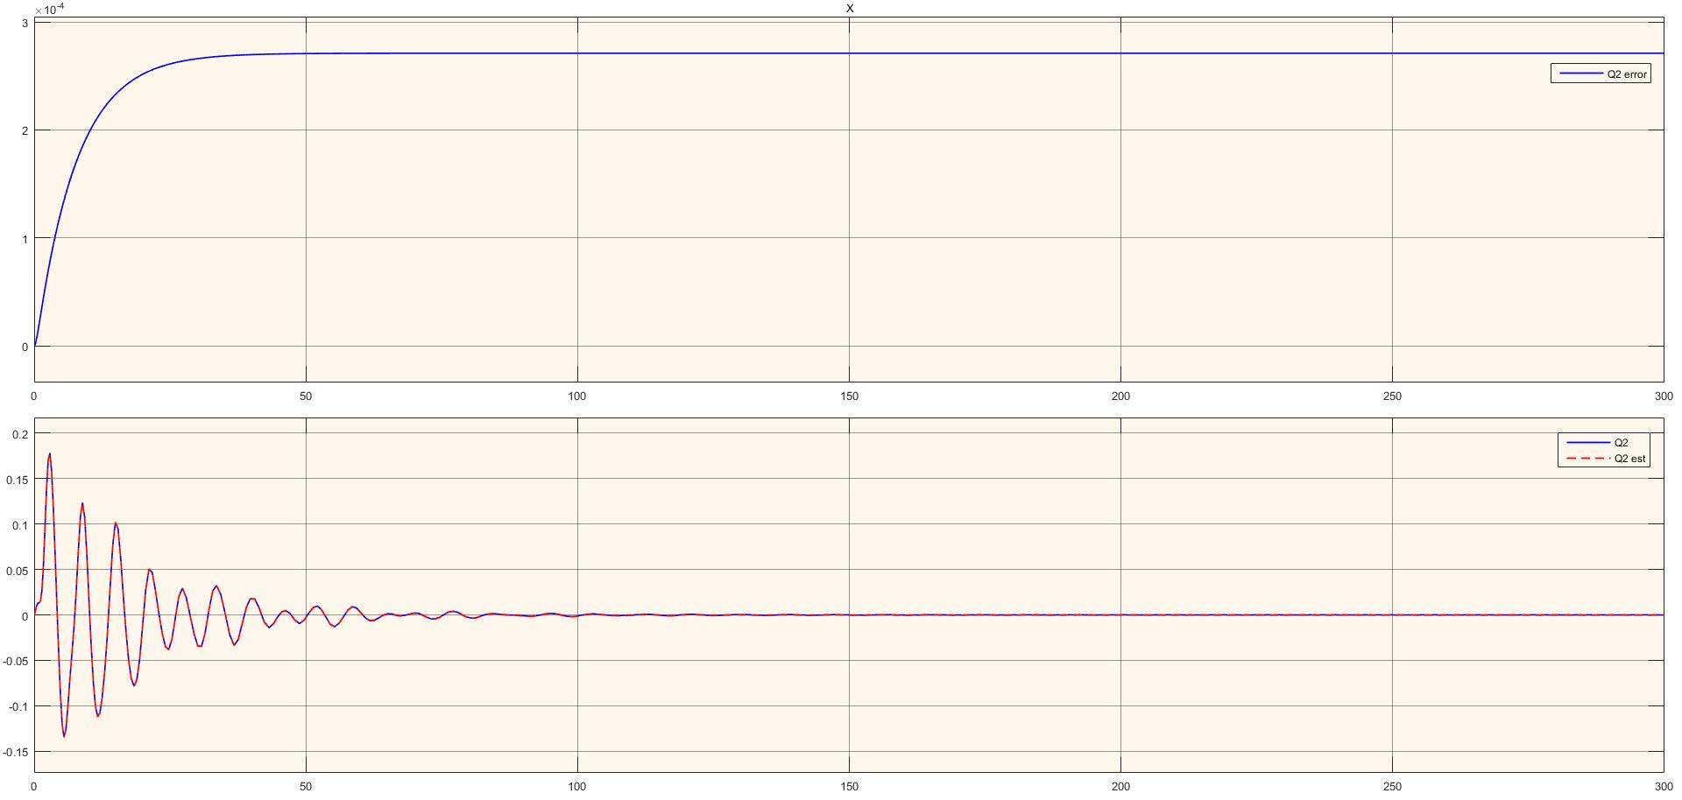
Observer tracing the Output Vector θ2(t)

Slide 47
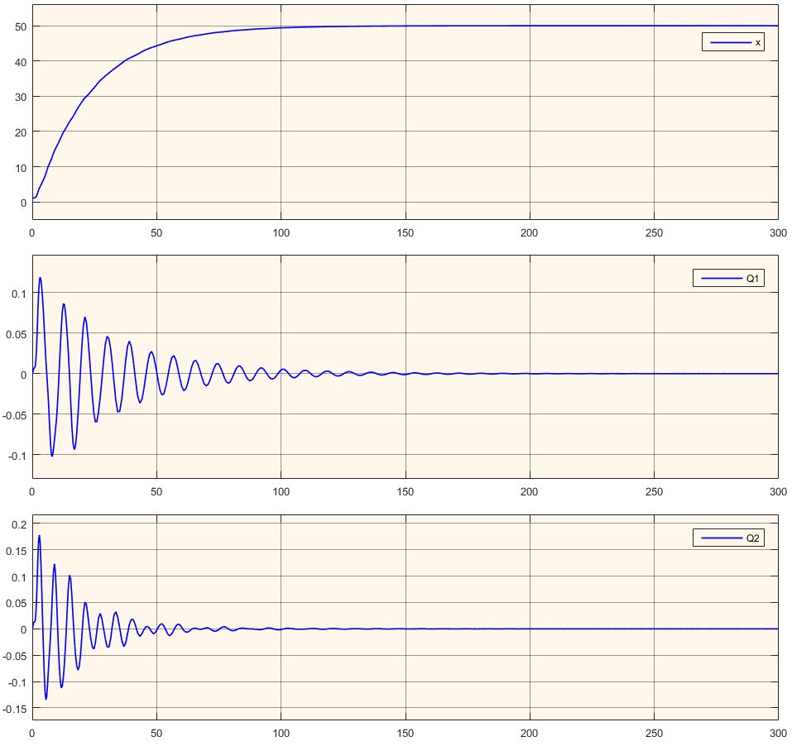
The (x, θ1(t), θ2(t)) States of the System

Slide 48
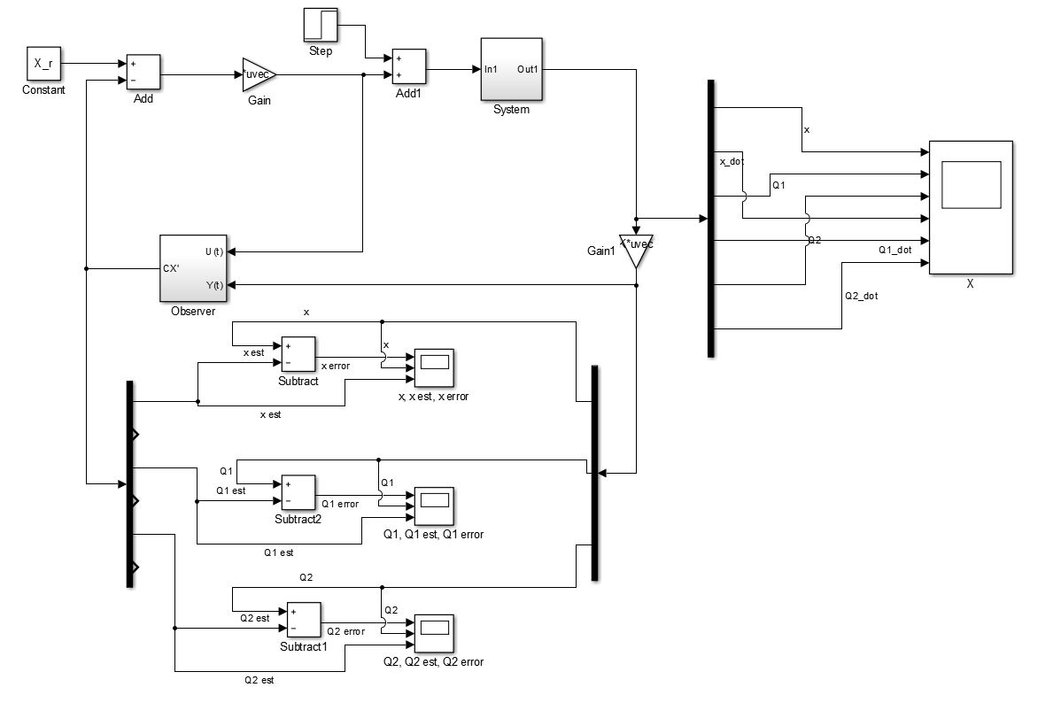
Non-Linearized System for Output Vector (x(t), θ1(t), θ2(t))

Slide 49
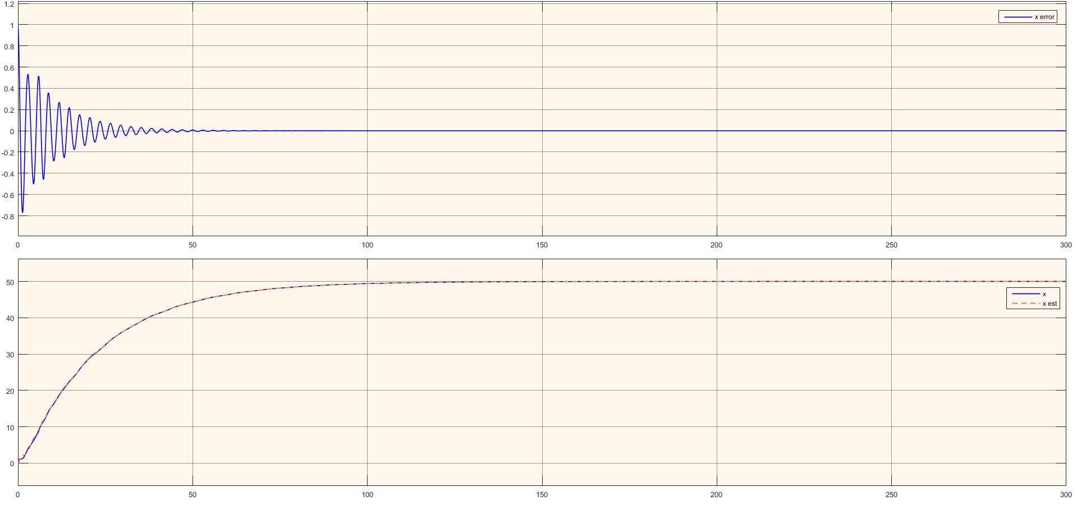
Observer tracing the Output Vector x(t)

Slide 50
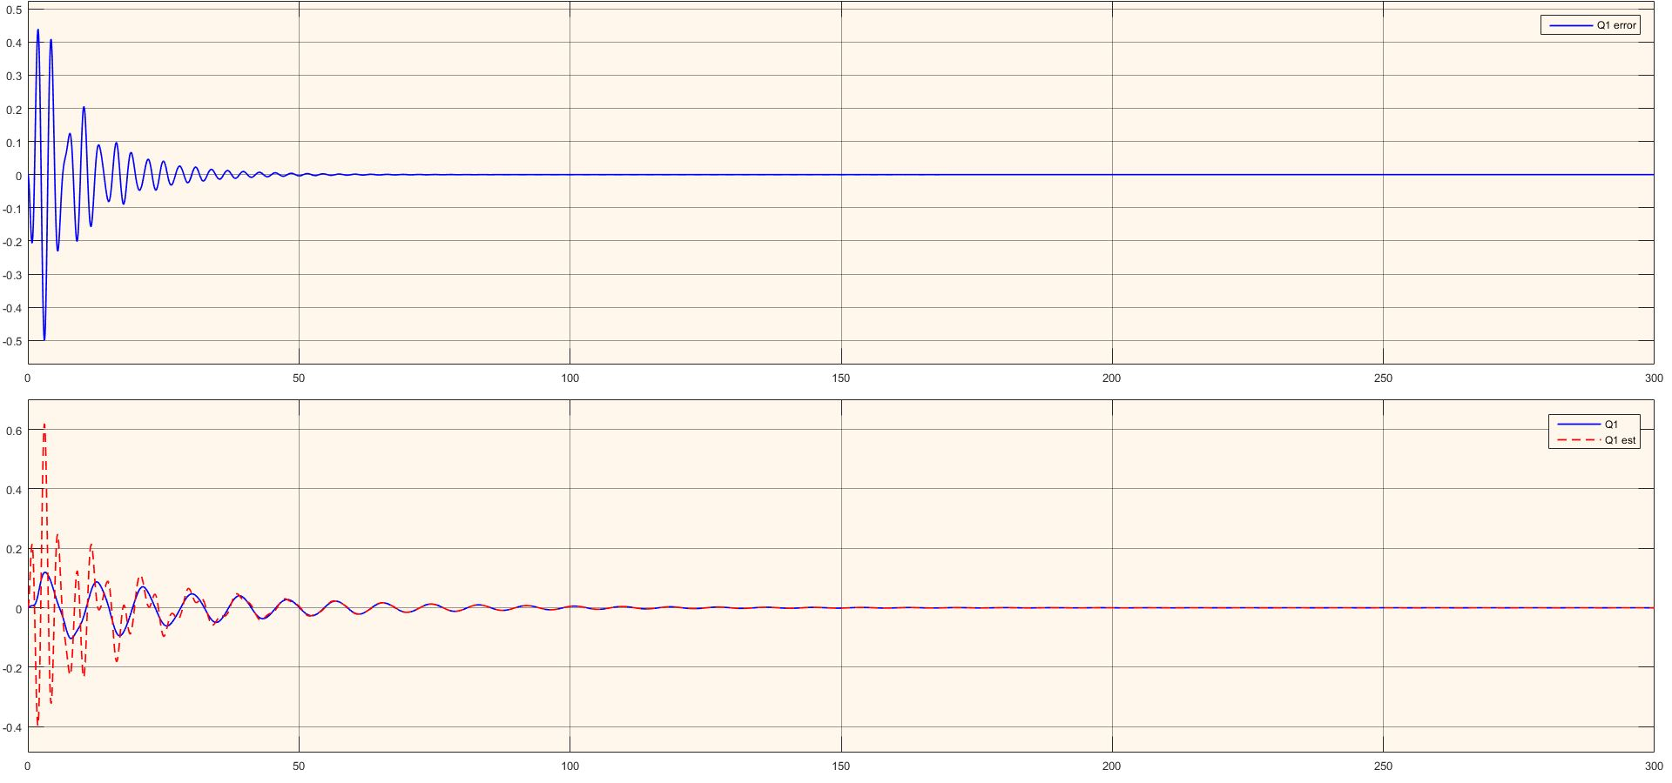
Observer tracing the Output Vector θ1(t)

Slide 51
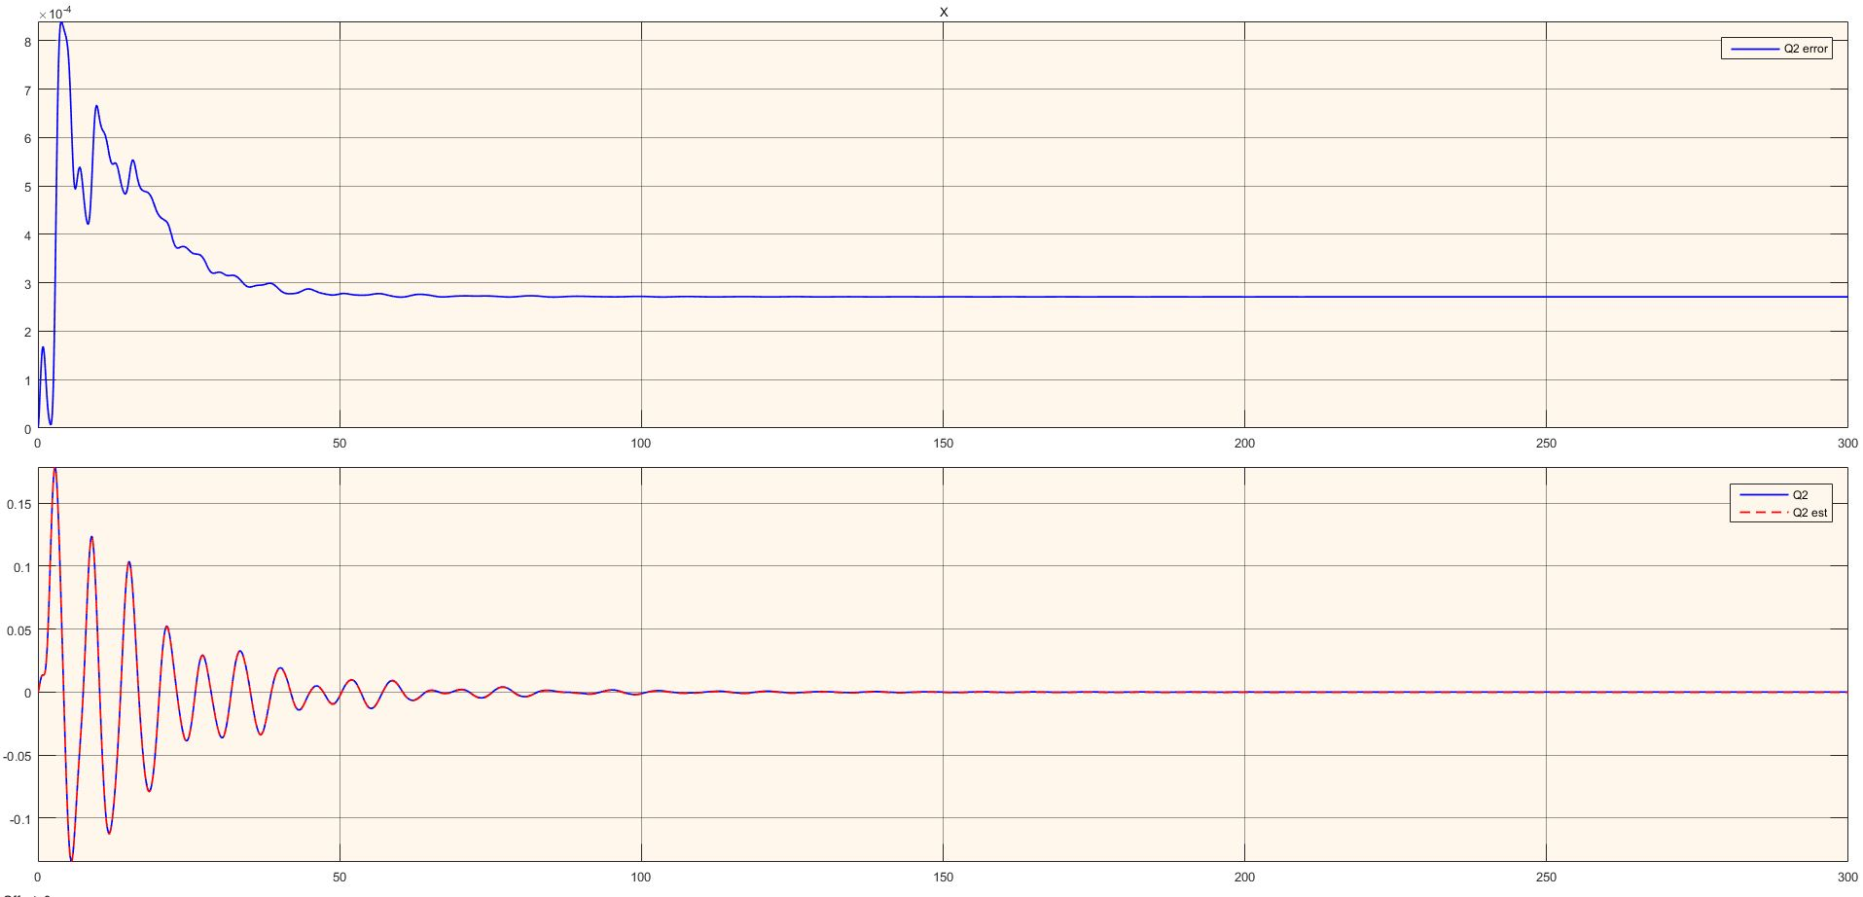
Observer tracing the Output Vector θ2(t)

Slide 52
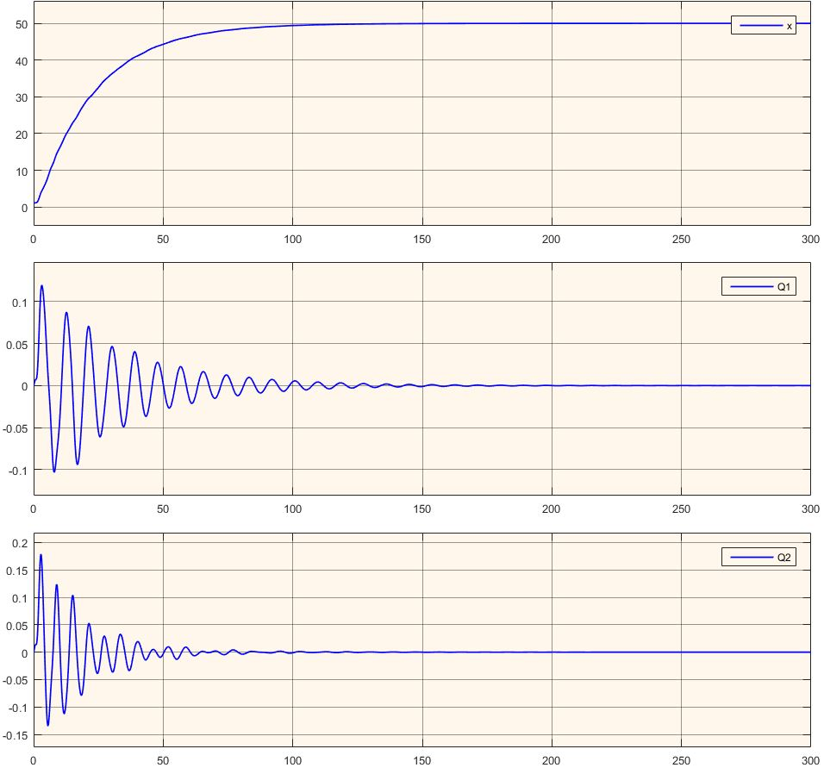
The (x, θ1(t), θ2(t)) States of the System

Slide 53
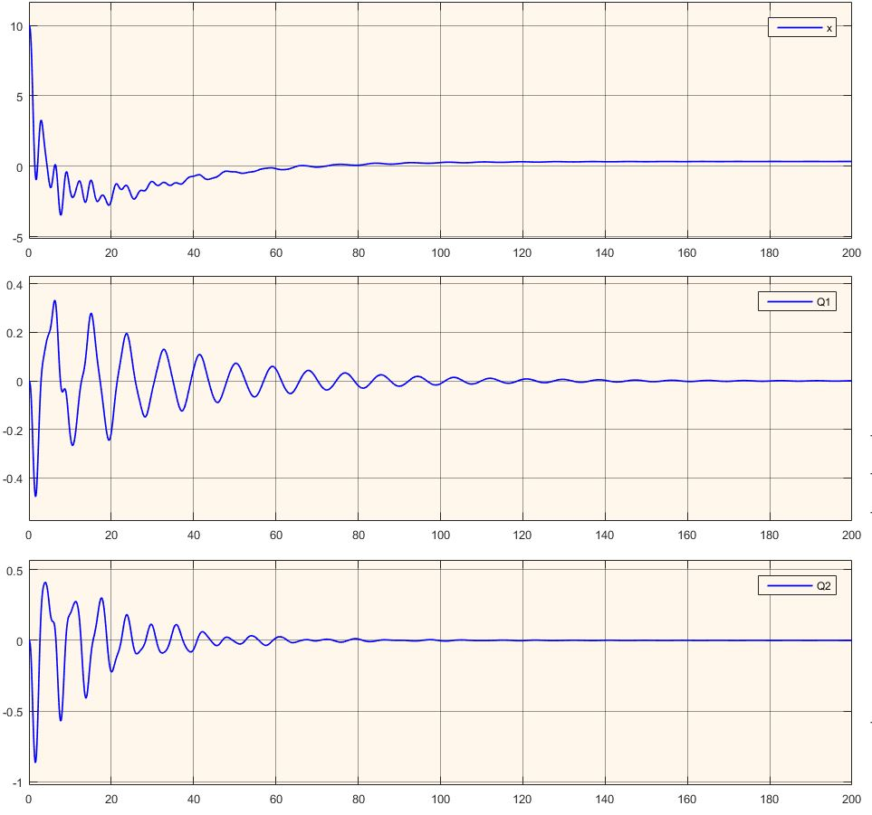
The (x, θ1(t), θ2(t)) States of the System

Slide 54
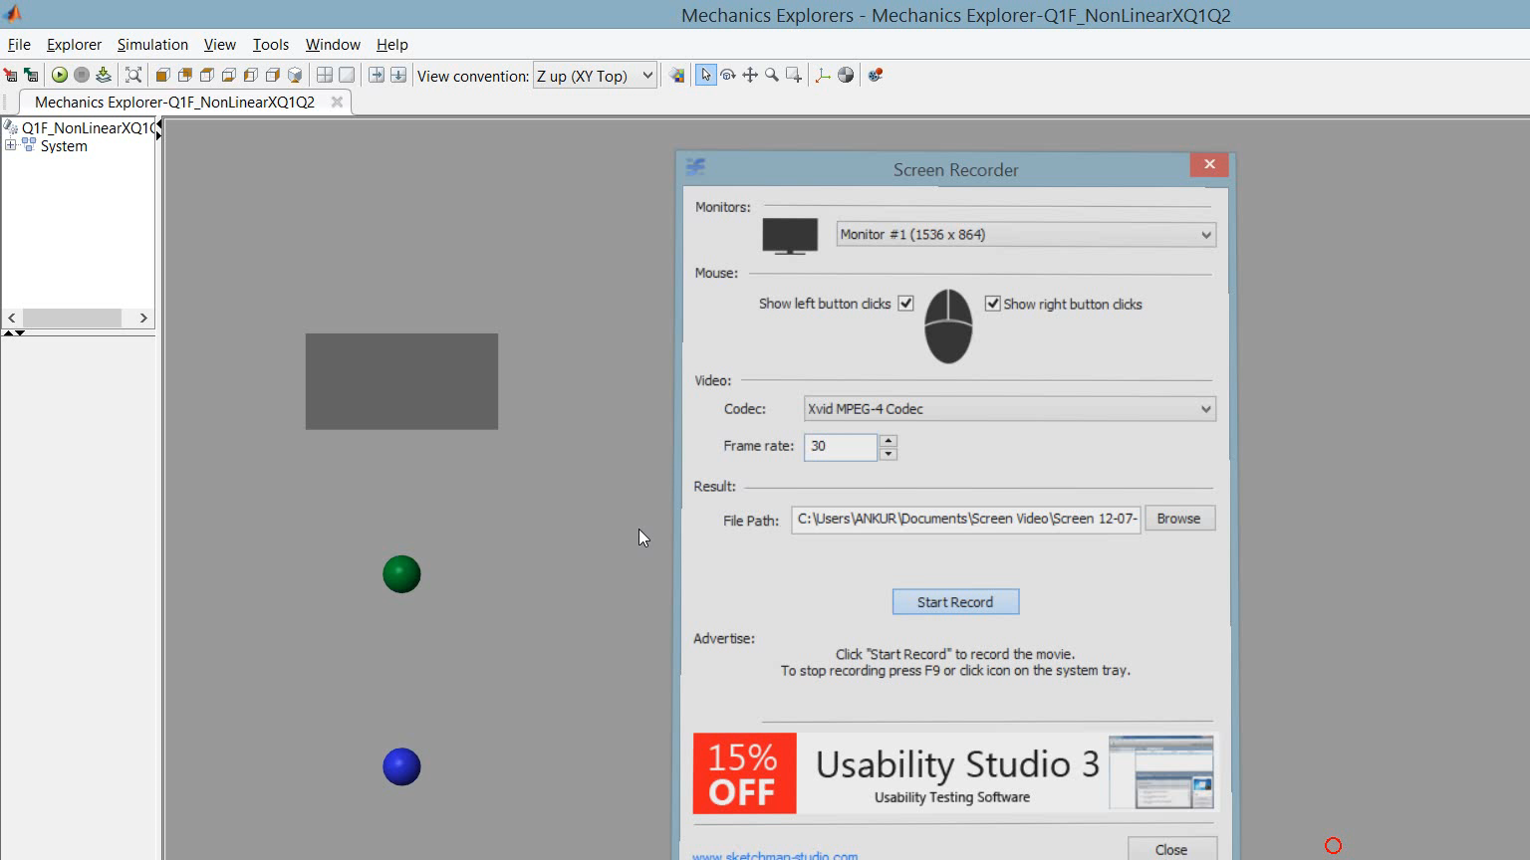
The System in Motion

Slide 55
Linear Quadratic Gaussian (LQG) Controller
LQG is equivalent to an observer(Kalman Filter) combined with a Linear Quadratic(LQR) Controller.
By Separation Principle, we can obtain the Kalman Gain ‘L’ for the Observer and the Controller Gain ‘K’ independently and then combine them to get the optimal LQG Controller

Slide 56
Linear Quadratic Gaussian (LQG) Controller
The two noises we consider during the construction of the LQG Controller:
Process Noise (Noise in the input to the system) with a Covariance Matrix Σd
Measurement Noise (present in the output of the system) with a Covariance Matrix Σv
reg = lqg(sys,QXU,QWV) - Matlab Code

Slide 57
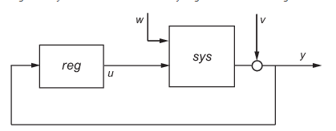
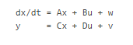

LQG Controller
Process Noise (present in the States ‘w’) and Measurement Noise (present in the output of the system ‘v’)
It is evident that the dimension of w is equal to that of states ($\frac{dx}{dt})$ i.e. w = (6x1) matrix
Also, the dimension of v is equal to that of output y i.e. v = (1x1) matrix

Slide 58

LQG Controller
The process noise w and measurement noise v are :
w = [0.1,0.1,0.1,0.1,0.1,0.1]'; %As low as possible
v = 0.1;
Thus the covariance matrices are
vvT = v*v'
wwT = w * w';
Re = blkdiag(wwT,vvT) ⁼
Similarly
We use
Qe=blkdiag(Q,R) %From previous value used for LQR
Finally we generate LQG from :
klqg=lqg(Linear_System,Qe,Re) where linear_system is the linear statespace model

Slide 59
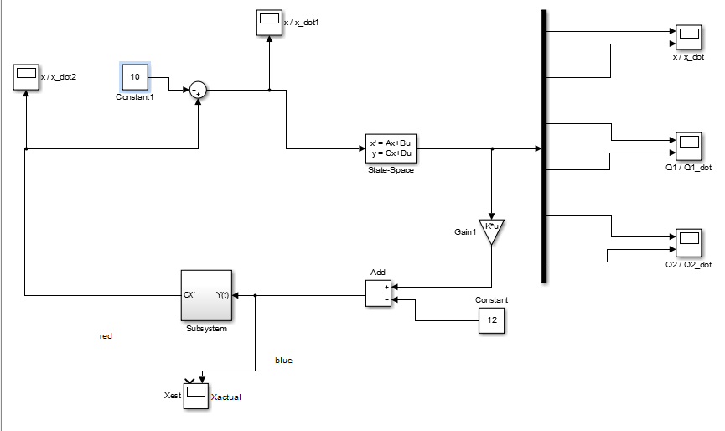
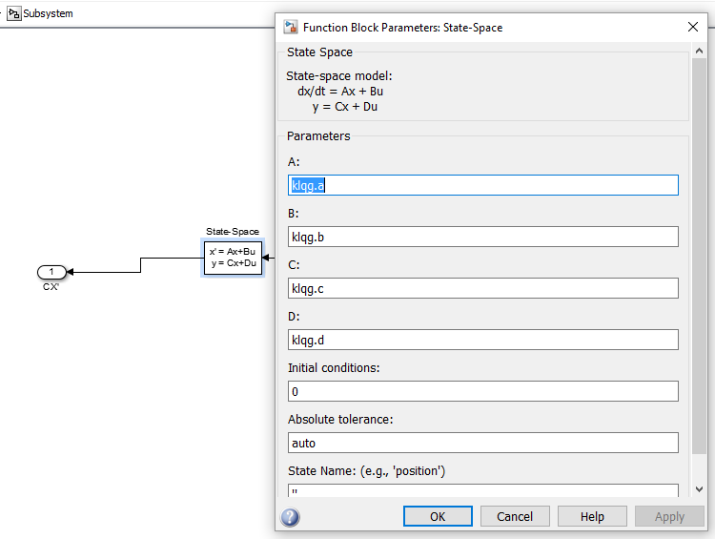
LQG Controller

Slide 60
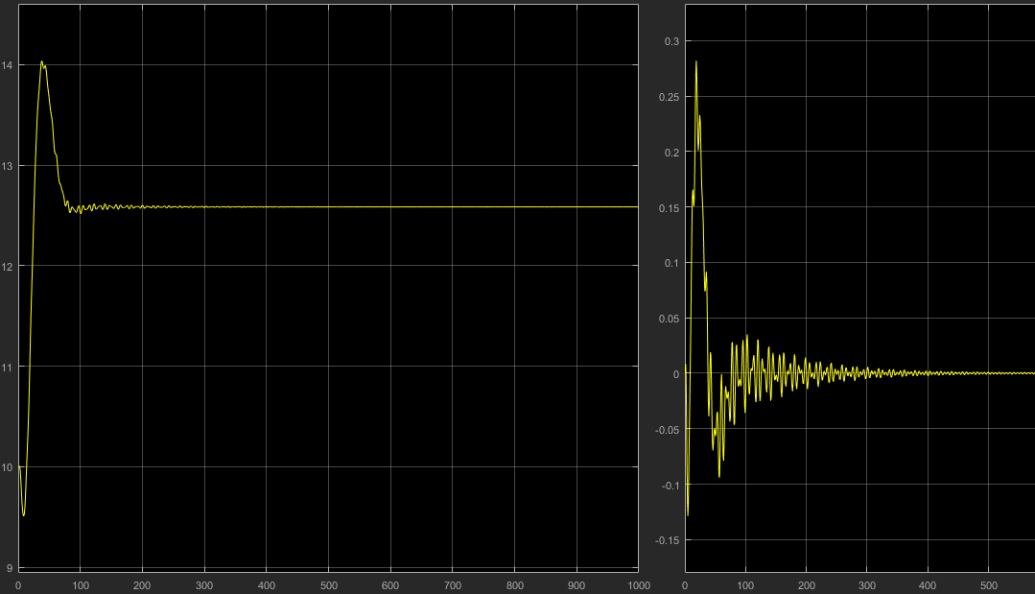
Output of the LQG controller with Fd = 10, X(0) = 10 and Xref =12
Notice Offset: Ref = 12
Basically, it’s a PD controller

Slide 61



Q1 and Q1_dot

Slide 62



Q1 and Q1_dot

Slide 63

Offset Correction
Add Integrator to track error in LQR Gain

Slide 64

X and X_dot
Error goes to zero after addition of integrator to the system
(Fd = 100)

Slide 65
Thank You!

